Slide 1
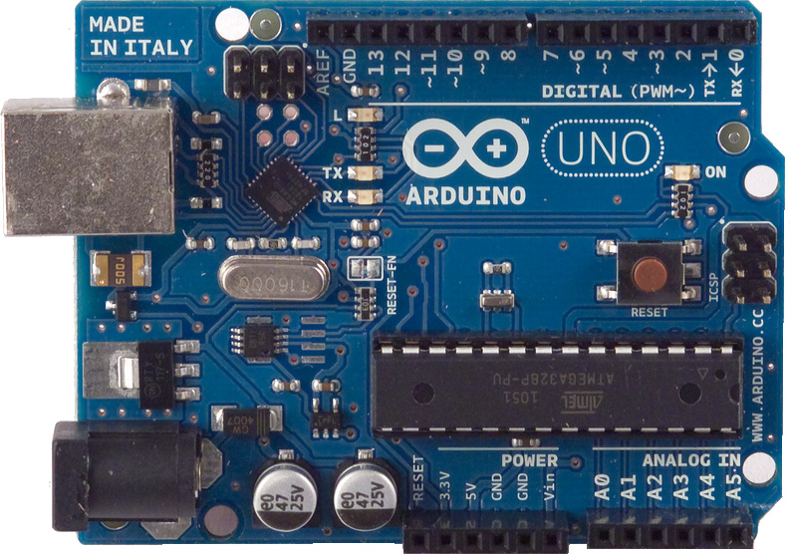
MAKE: Hands-on Intro to Engineering Design
Deliverable 6 Video: Discussion of the Arduino Sketch: <enter name of your project>
Please, replace this figure with your own. Use a nice shot of your breadboard setup or from your 3D simulation.
Author: <enter your name>
Date: Fall 2016
This video will present:
A brief intro to the design of my project and its control system
A discussion of the Arduino sketch used to control my project. All major functions of the project will be discussed.

