Slide 1
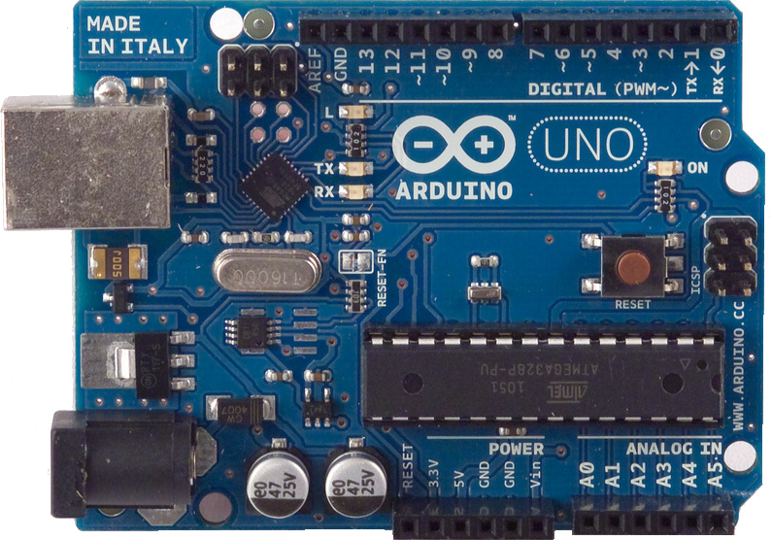
MAKE: Hands-on Intro to Engineering Design
Deliverable 3: Finalized Design Proposal for <enter name of your project>
Author: <enter your name>
Date: <semester> <year>
This video will present:
An animated video of my project
A description of its functionality and its control system
Please, replace this figure with your own. Use a nice shot of your 3D model.

Slide 2
Control System Block Diagram:
Skittles Gun
Skittles gun launch
trigger
IR Sensor
Remote
Servo 1
Arduino
LCD
launch counter
Servo 2
Skittles gun turret rotation
LED on/off
LED/launch
LED need refill

