Slide 1
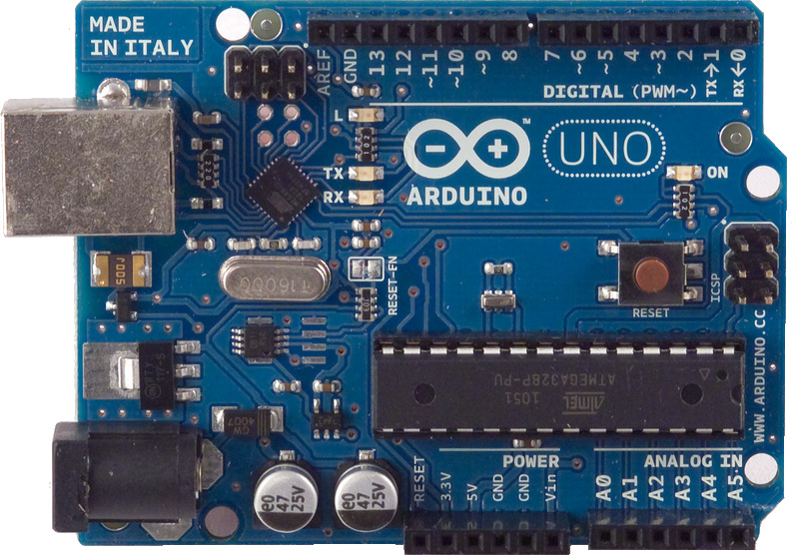
MAKE: Hands-on Intro to Engineering Design
Deliverable 5 Video: Demonstration of the Arduino Based Control System: <enter name of your project>
Author: <enter your name>
Date: Fall 2016
This video will present:
A brief intro to my project
A discussion of my control system and its breadboard implementation. All functions of the control system will be demonstrated and explained in this video
Please, replace this figure with your own. Use a nice shot of your breadboard setup.

